Slide 1

StyleMe
CALHACKS 5.0
SAHIL SANGHVI
JACQUELINE ZHANG
UC BERKELEY

Slide 2
HELLO.

Slide 3

WATSON’S FORESIGHT.
YOUR STYLE.
What the heck
is StyleMe?
StyleMe is a piece of software which makes practical outfit combinations based on factors such as real-time weather.

Slide 4

WHAT’S
THE
WEATHER
StyleMe implements the OpenWorldMap API in order to fetch high-quality, real-time weather data for the user’s location.

Slide 5
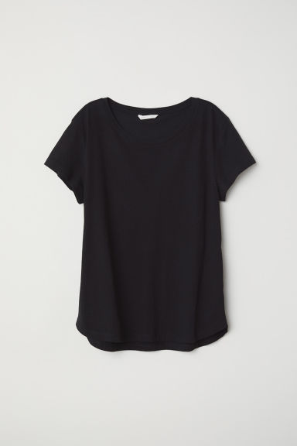
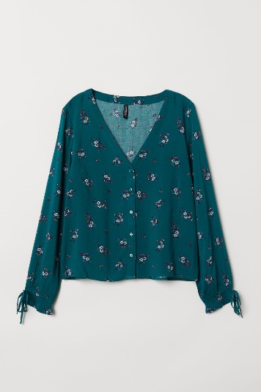
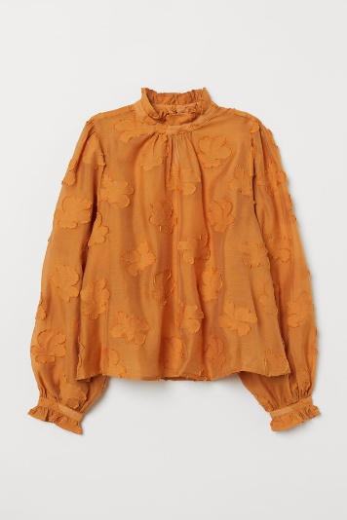
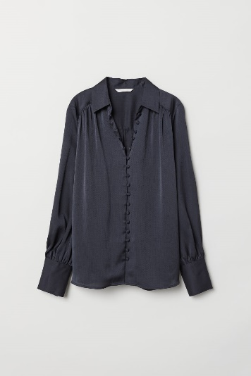
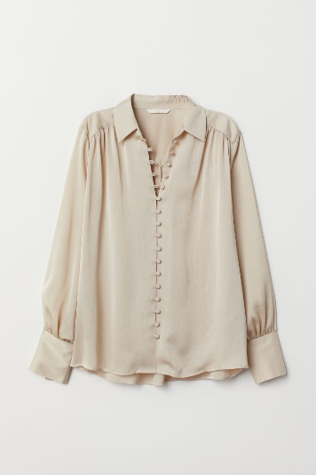
IBM Watson. A Fashion Icon?
“
“
The high temperature is 84 degrees.
The low temperature is 72 degrees.
The wind is 2.1 mph, which isn’t too bad.
So, I should choose t-shirts, not blouses, for the top.
Jackets are optional.
”
A REAL QUOTE FROM IBM WATSON
StyleMe uses IBM Watson’s Vision-Recognition system, for which we created a custom classifier based on over 1100 sample data points. This means Watson now differentiates articles of clothing.

Slide 6
THANK YOU

